Slide 1

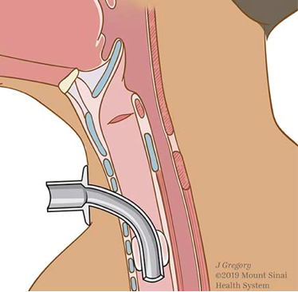
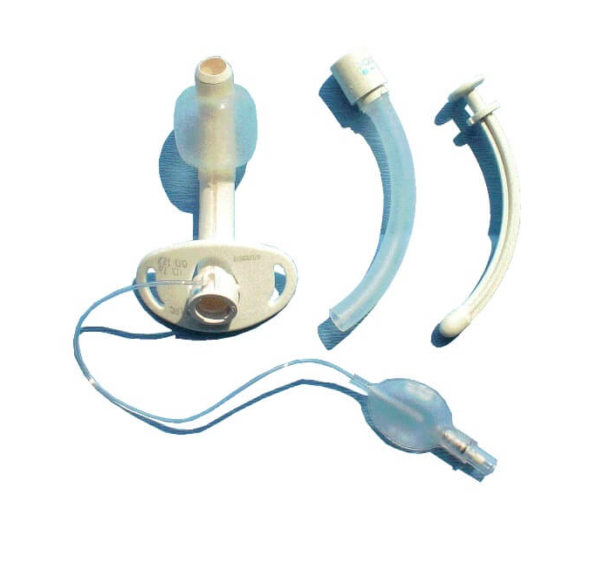
An Overview of the Complications and Outcomes Associated with Tracheostomy from a National Standpoint
Bracha Robinson, MD; Premal Patel, MD; Palak Patel, DO; Ivan Richards, MD; Giuseppe Filice, MD; Gustavo De La Luz, MD; Pramil Cheriyath, MD
Department of Internal Medicine, Hackensack Meridian Health Ocean Medical Center, Brick NJ
Background
Tracheostomy is one of the oldest procedures performed in history and it was first described as early as 100 B.C., by a Greek physician Asclepiades.
During the past few years, studies have shown that early tracheostomy in intubated patients improved the overall outcome.
Previous studies have shown that the complications associated with tracheostomy can be as high as 48%.
Although the complication rate has come down in recent clinical practice, physicians might not consider tracheostomy often due to its invasive nature.
To date, most of the studies have used ICD-9 CM codes while looking for the complications associated with tracheostomy.
Our objective of the study is to discuss the complications associated with tracheostomy using ICD-10 CM codes from the most recent national database.
Figure1: Racial distribution in the study population
Demographics
RACE | Tracheostomy (N) | Tracheostomy (%)
Caucasians | 127,170 | 60.40%
African-Americans | 42,530 | 20.20%
Hispanic | 20,975 | 10.00%
Native Americans | 19,750 | 9.40%
Total | 216,590 | 100.00%
Figure 4: Pie chart showing the complication rate in the study population
Figure 2: Table showing the number and percentage of people from who underwent for tracheostomy from each race
N = Number of patients
Methods
We conducted a retrospective cohort study using a publicly accessible national survey data, the National Inpatient Sample (NIS) database from October 2015 to December 2017.
Adult patients (>18), who underwent tracheostomy procedures were included in the study.
The data was analyzed for in-hospital mortality and complications associated with tracheostomy in critically ill patients from a national standpoint.
SAS is a ready to use program for data analysis and descriptive statistics.
Among them, 7,230 (3.34%) patients developed complications. Most common complications were hemorrhage from the tracheostomy stoma and tracheal stenosis.
In-hospital mortality was 25, 610 (11.83%) after the procedure, which was most likely due to the underlying co-morbidities, with an average length of stay of 30.0 (15.0 - 37.0) days.
Figure 5: Anatomy of tracheostomy and tracheostomy tubes
Tracheostomy Complications | Number of Patients | Tracheostomy Complications(%)
Hemorrhage from Tracheostomy Stoma | 3,730 | 1.72%
Tracheal Stenosis | 2,385 | 1.10%
Infection at Tracheostomy Site | 880 | 0.41%
Tracheo-esophageal Fistula | 190 | 0.09%
Unspecified | 45 | 0.02%
Conclusion
Based on the ICD-10 code analysis from the national database, we found that in recent years, the most common complications of tracheostomy are hemorrhage from the tracheostomy stoma and tracheal stenosis.
However, the overall complication rate has come down.
Physicians must be aware of this trend, and consider tracheostomy more often whenever there is a clinical indication.
Results
There were a total of 216,590 tracheostomy procedures performed. In this sample, caucasians (60.43%) and African Americans (20. 21%) were predominant.
Figure 3: Table showing the complication rate in the study population

